Slide 1

Lesson: 1.01 Setup
Microsoft Philanthropies TEALS Program
Introduction to Computer Science
Semester 2

Slide 2
Setup
After this lesson, you will be able to...
Define and identify IDE and Python
Identify the key concepts that will be covered in the course
Set up and log into an account for the course's online IDE
Save and turn in a file via the online IDE

Slide 3
Today’s Plan
Do Now
Syllabus
Python/IDE Intro
Students Create Accounts & Submit Work

Slide 4
Do Now
Read Through the Setup Handout
Notes:
Give students 3-4 minutes to follow the instructions on the Do Now page.
Debrief the answers to the questions on the Do Now by calling on students to respond.

Slide 5
Syllabus
Goals for this course
Create functioning Python programs,
Learn to use basic data types
Earn to use a text-based language.
Present demo of a program written in Python to hook students and to give them an idea of what they will be working with.
Notes:
Remind students of creating a block in Snap!

Slide 6
Overview of this course
The major topics covered in this course are as follows:
Variables
Conditionals
Loops
Functions (user-defined and built-in)
Lists
Classes and Objects
Dictionaries
Music Programming
Notes:
Feel free to edit this slide based on the guidance from the curriculum map and the goals for this course.

Slide 7
Lab Projects
Unit 1: MadLibs
Unit 2: Text Adventure Game
Unit 3: Oregon Trail Game
Unit 4: Tic-Tac-Toe (2 Human Players)
Unit 5: Music Programming in Earsketch
Unit 6: Guess Who? Game
Unit 7: Pokémon
Unit 8: Final Project - Student Imagined
Notes:
Feel free to edit this slide based on the guidance from the curriculum map and the goals for this course.

Slide 8
Notebooks
All of you will be expected to keep a notebook to take notes in the course.
There will also be activities throughout this course where you will need a notebook.

Slide 9

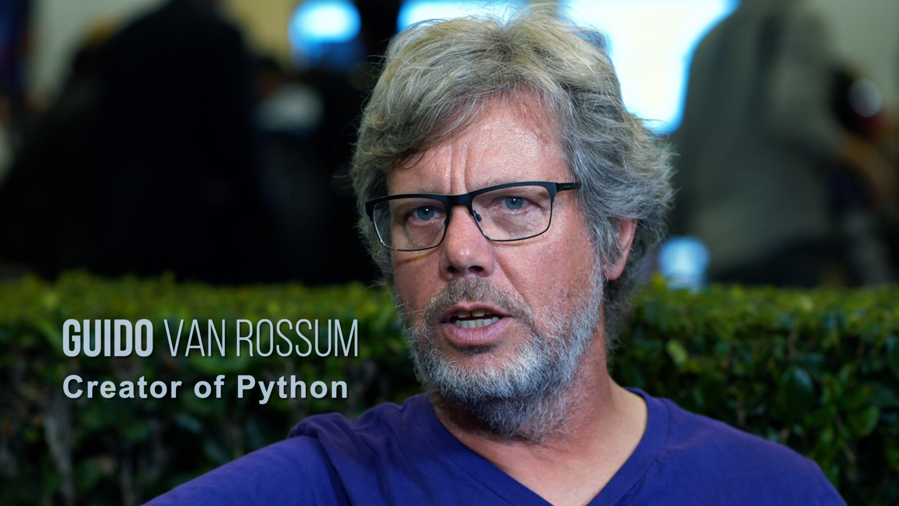
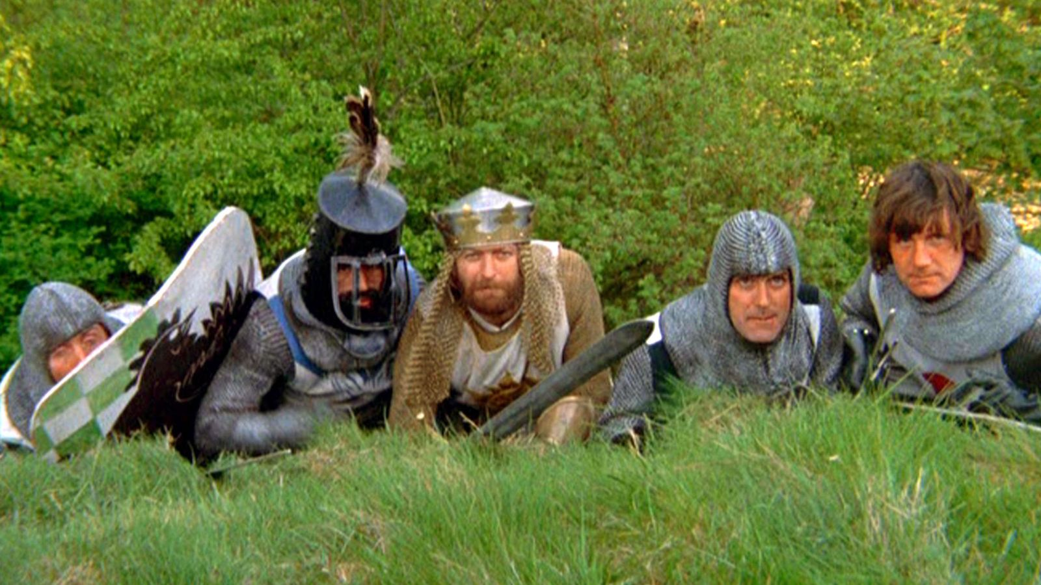
What is Python?
Python is a text-based programming language.
First released 1991. Python3 released 2008.
Widely used in industry and academia.
100,000,000+ lines of python at Google, Inc.
Invented by Guido van Rossum in the Netherlands.
Known for its readability.
Named after BBC TV show Monty Python's Flying Circus.

Slide 10

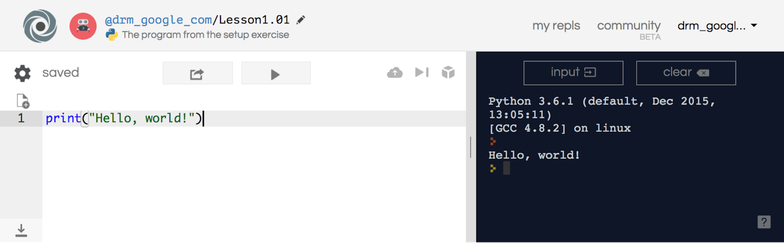
Repl.it
IDE - Integrated Development Environment
http://repl.it/ (Read, Evaluate, Print, Loop)
An IDE is an application that allows you to create, edit, save, and run programs.

Slide 11
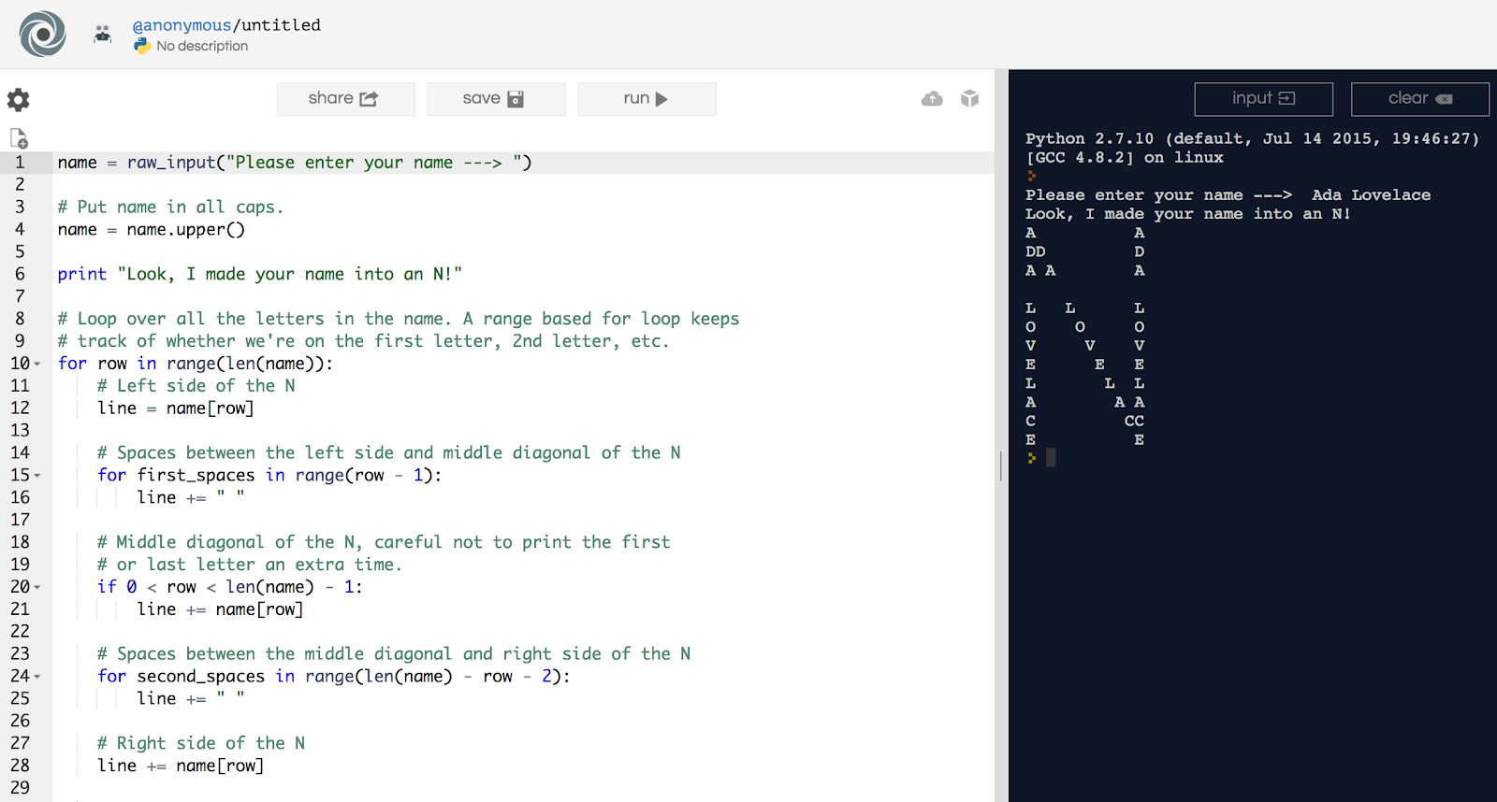
Repl.it Interface
Code
Output or result

Slide 12
Repl.it Features
Interactive Console
Multi-file projects
Useful for data files
Syntax color-coding
All files publicly readable

Slide 13
Setup Repl.it
Follow along in the Repl.it Setup Guide to make your account.

Slide 14
Hello World
Write the following program to print “Hello World”
Quotation marks matter.
Parentheses matter.
Text coloring happens automatically.

Slide 15
Exit Ticket
In your notebook, Write down two things you learned today.

